Slide 1
Advanced Computer Architecture
School of Computer, National University of Defense Technology
Lecture 07. Multi-Issue
Dr. SHEN Li
2019.11.20

Slide 2
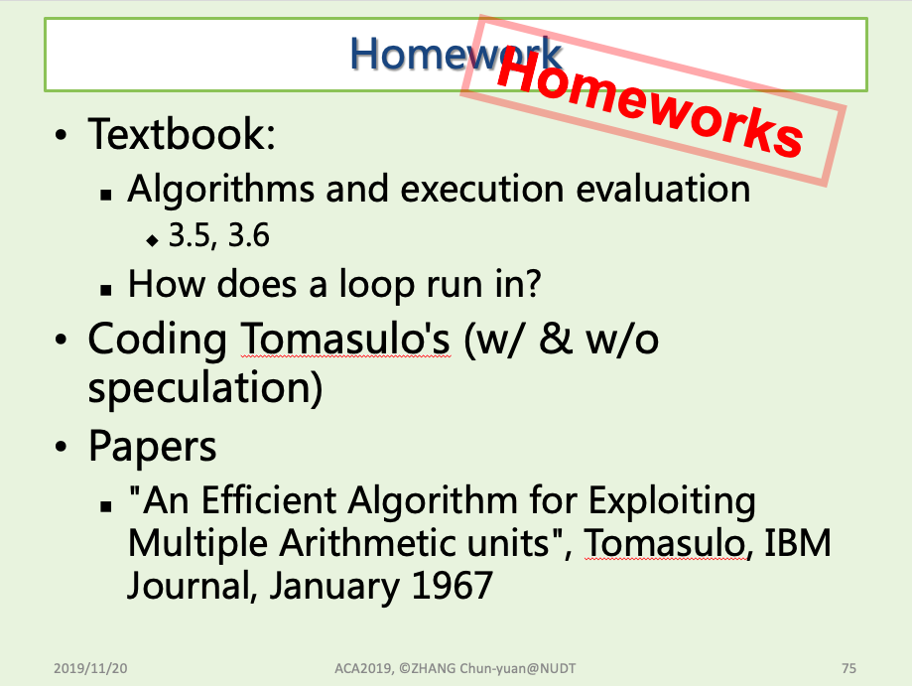
Review & Comments

Slide 3
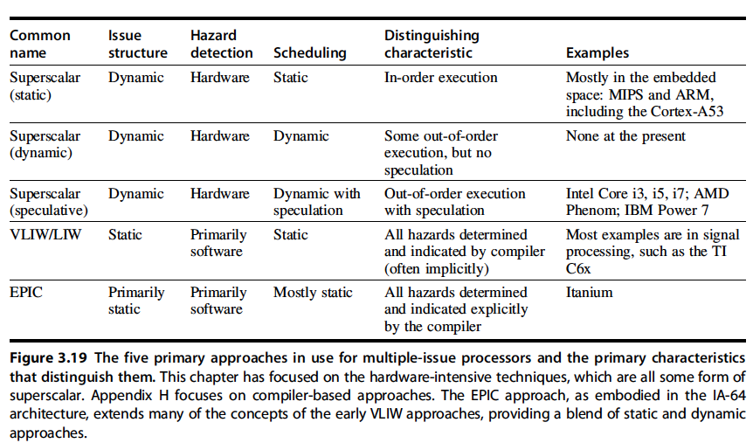
Five primary approaches in use for multi-issued processors

Slide 4
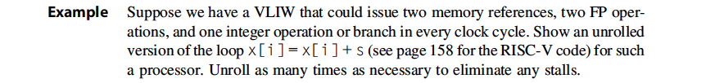
An example for VLIW codes
Loop: fld f0,0(x1) //f0=array element
fadd.d f4,f0,f2 //add scalar in f2
fsd f4,0(x1) //store result
addi x1,x1,8 //decrement pointer
//8 bytes (per DW)
bne x1,x2,Loop //branch x16.x2

Slide 5

An example for VLIW codes
Loop: fld f0,0(x1)
addi x1,x1,8
fadd.d f4,f0,f2
fsd f4,0(x1)
stall
stall
bne x1,x2,Loop
Loop: fld f0,0(x1)
fadd.d f4,f0,f2
fsd f4,0(x1)
addi x1,x1,8
bne x1,x2,Loop

Slide 6
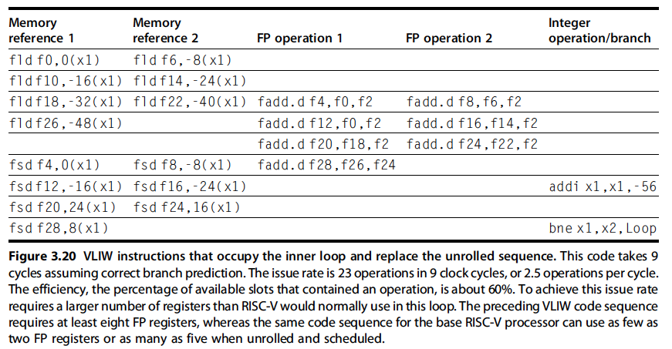
An example for VLIW codes

Slide 7
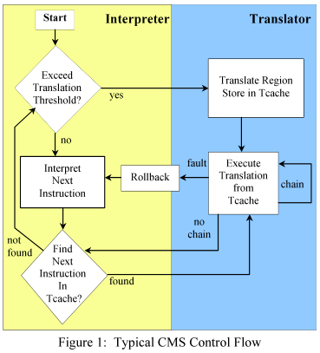
Transmeta Code Morphing Software

Slide 8
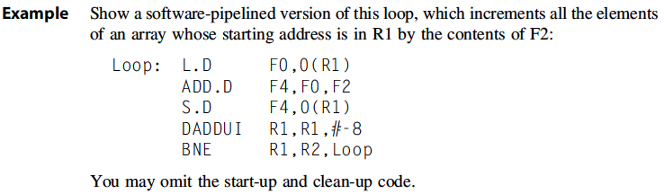
Software pipelining

Slide 9
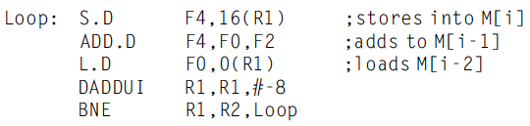
Software pipelining

Slide 10
Homework
Textbook
H.6 The Intel Itanium Architecture and Itanium Processor
Paper
The Transmeta Code MorphingTM Software: Using Speculation, Recovery, and Adaptive Retranslation to Address Real-life Challenges

